Slide 1
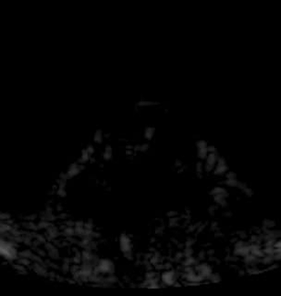
In vivo imaging
Imaging schematic
Tumor/focus
Mouse
Water bowl
Imaging transducer
BxPC3 xenograft
5 min FAPI acquisition, 15x
Notes:
We can do all the in vitro optm. If doesn’t work in vivo, useless
Set up imaging set up
BxPC3 xenograft in nude mice
Injected microbubbles, observed over 5 min period
Wash-in, wash out.
Drawing ROI over tumor, can assess MB half-life
If you watch closely, can see accumulation inside the tumor

Slide 2
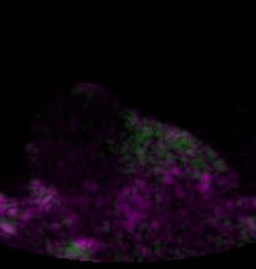
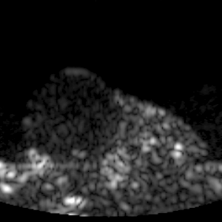
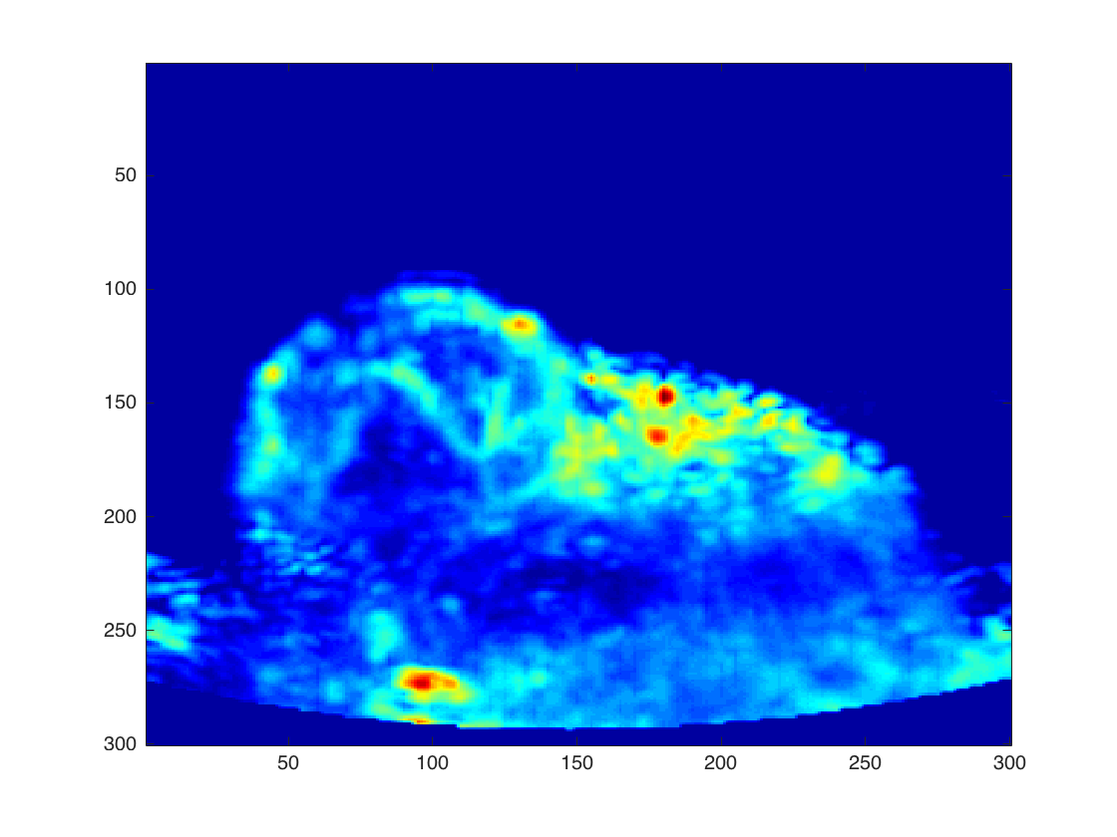
In vivo overlay
A
B
5mm
Purple – FA
Green – FAPI
Notes:
Another practical use – overlay the “normal” + contrast
Here, FA is in…. Realt time
In the B image, we have max intensity over 5 sec, can identify sub mm structures
Low frequency contrast imaging is effective!
Extra benefit (using low freq) – closer to therapeutic freq range
→ USgFUS with single probe.

Slide 3
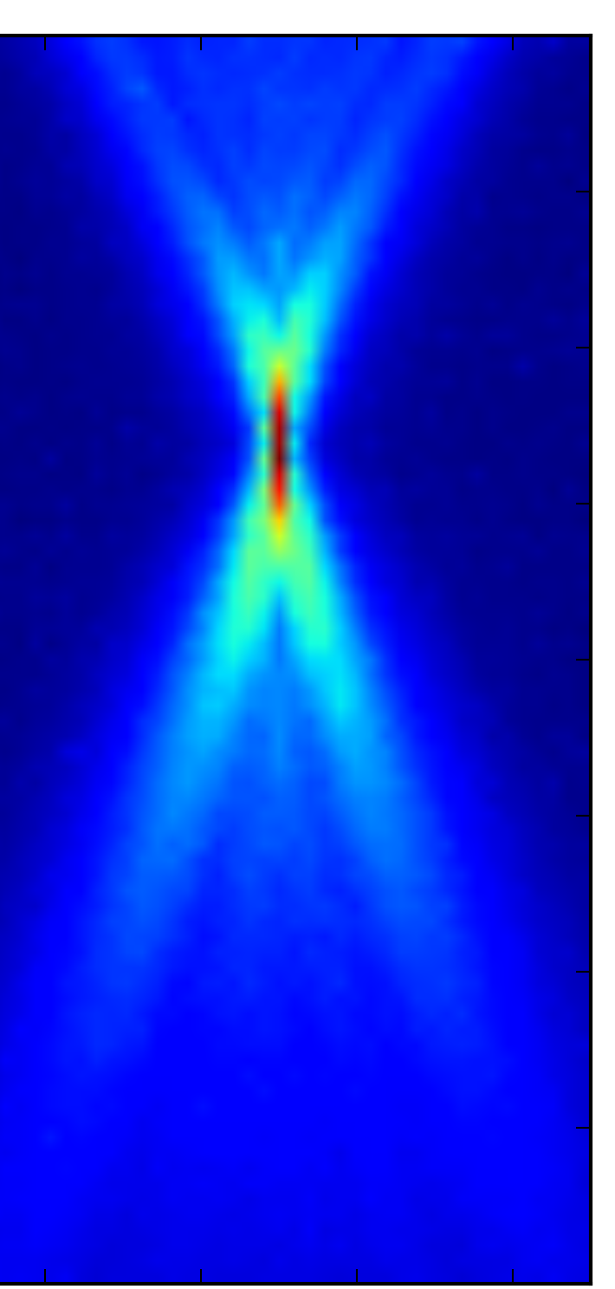
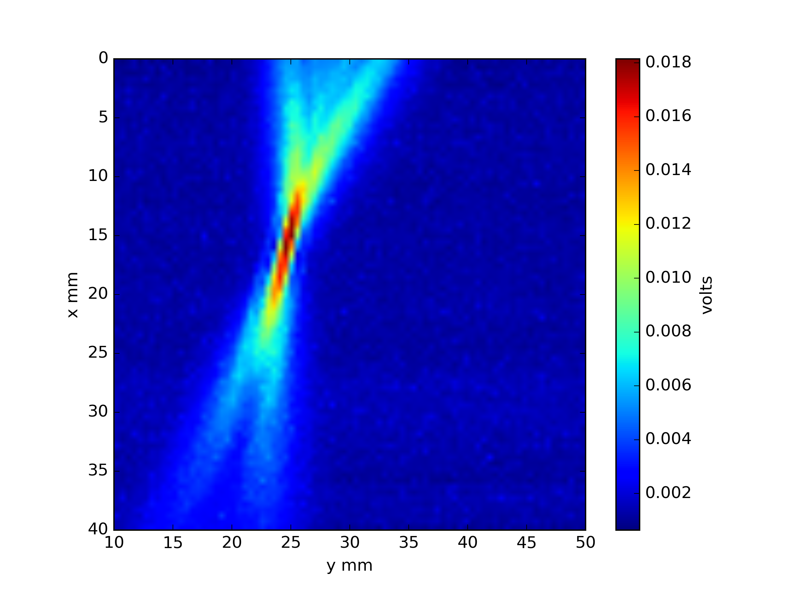
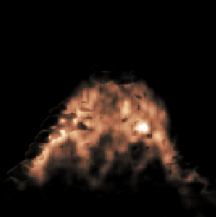
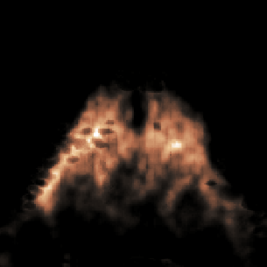
P4-1 output pressure (at focus)
Treatment timeline
Pre-treatment FAPI
(confirm MB)
>7
minutes
Post-treatment FAPI
MB injection
USgFUS treatment
MB injection
Pre-treatment
*
5mm
Post-treatment
*p < 0.01
Notes:
Beam map of focused beam, characterized pressure output
Combined with MB, sufficient to cause bubble cavitation → therapeutic effect
USgFUS treatment – collect FA, choose treatment foci on screen, steer the beam
In the experiment timeline….
Drew ROI over... Plotted against time
Overall, saw 39% reduction in perfusion into treatment focus

